Slide 1
Angular training
Introduction to Angular

Slide 2


Slide 3
Angular
ANGULAR - INTRODUCTION TO ANGULAR PRINCIPAL
Comprehensive framework for building scalable and robust web applications.
Developed and maintained by Google, ensuring long-term support and continuous improvements.
Built with TypeScript, offering strong typing and modern JavaScript features.
Component-based architecture that promotes modularity and reusability.
Foundation for mobile app development using frameworks like Ionic.
A key part of the MEAN Stack (MongoDB, Express, Angular, Node.js), commonly used for full-stack JavaScript applications.
📘 Official documentation: https://angular.io

Slide 4
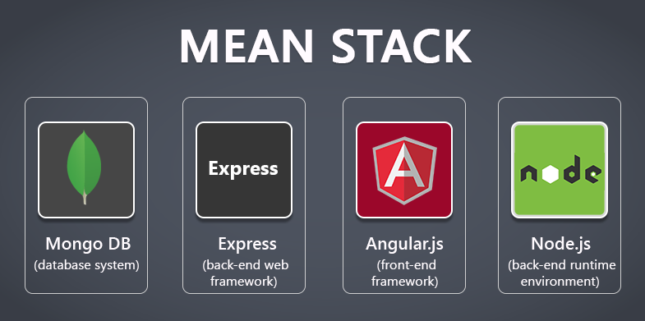
ANGULAR - INTRODUCTION TO ANGULAR PRINCIPAL

Slide 5
What is a stack?
 | MEAN / MERN/ MEVN - Javascript | LAMP - Different language | Java Stack | Python
Database | MongoDB | MySQL | Postreql / Oracle | Postresql / MySQL
Backend web framework | Express JS | Apache / Nginx | Spring Boot | Django / Flask
Front end web framework | Angular / React / VueJS | PHP, Python, Perl | JSP, JSF , or SPA | SPA
Backend Runtime environment | NodeJs | Linux | Tomcat server | Linux
Mobile app | Ionic / React Native |  | Native Android (Java) / IOS
Data |  |  |  | Can do data science easily

Slide 6
Case Study AirBnB
Language | Java, JS
Database - Normally we will have 2 databases - Transactional, Data processing, Caching | MySQL, RDS , Redis, Hadoop
Backend web framework
Front end web framework | React, Rails
Backend Runtime environment | EC2 (Linux)
Mobile app
Data
Based on https://stackshare.io
https://stackshare.io/airbnb/airbnb/

Slide 7
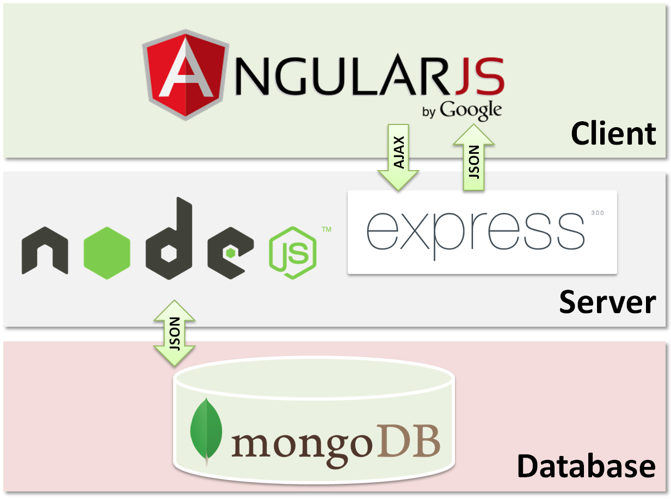
What is MEAN?
MEAN is an opinionated fullstack javascript framework - which simplifies and accelerates web application development.

Slide 8
Why MEAN?
MEAN stands for MongoDB, Express.js, Angular, and Node.js — a full-stack JavaScript framework for developing web applications.
Angular plays the role of the front-end framework, handling the user interface and client-side logic.
Being TypeScript-based, Angular brings structure, scalability, and maintainability to large-scale front-end applications.
Angular seamlessly communicates with Express.js and Node.js on the server side using HTTP and JSON, ensuring a smooth full-stack JavaScript development experience.
Its component-based architecture and powerful tooling make Angular a robust choice for building dynamic, responsive web interfaces in MEAN applications.
Since all technologies in MEAN use JavaScript (or TypeScript), there's consistency across the entire stack, making development faster and easier to manage.

Slide 9
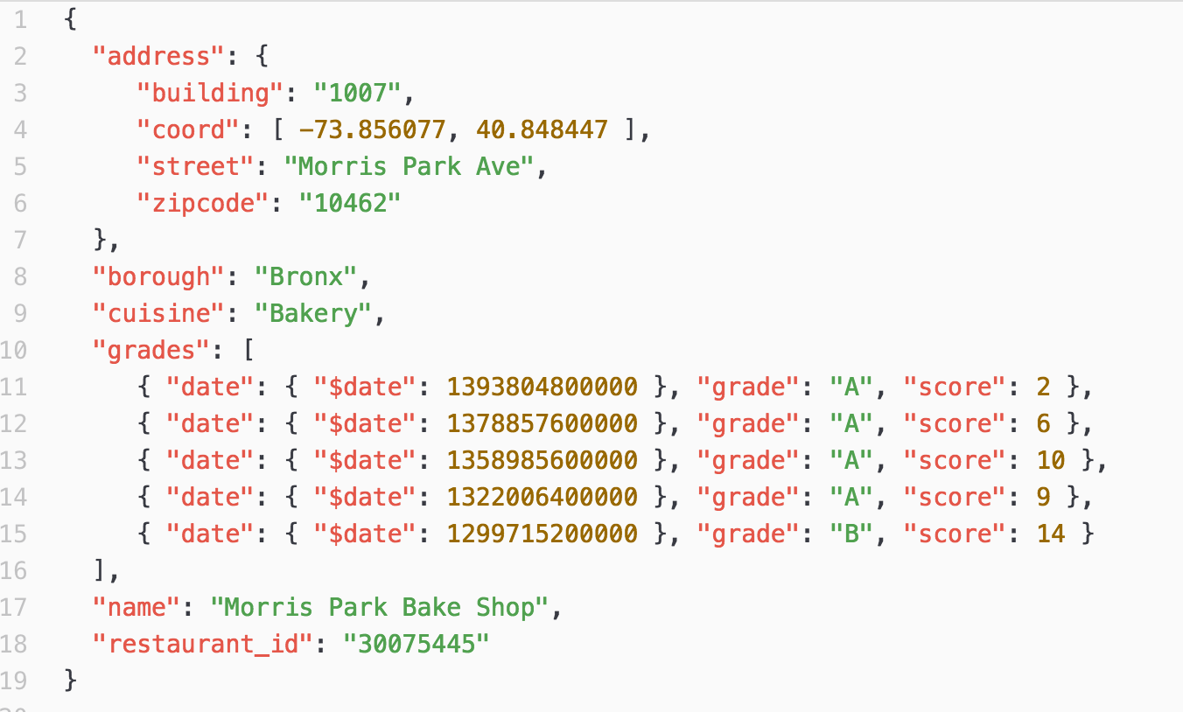
Data stored in MongoDB (example)

Slide 10
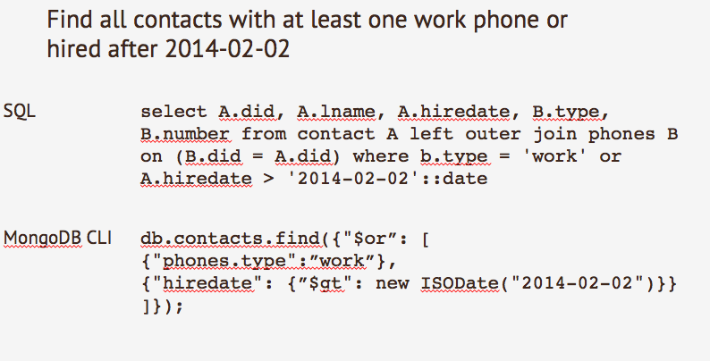
MongoDB query example

Slide 11
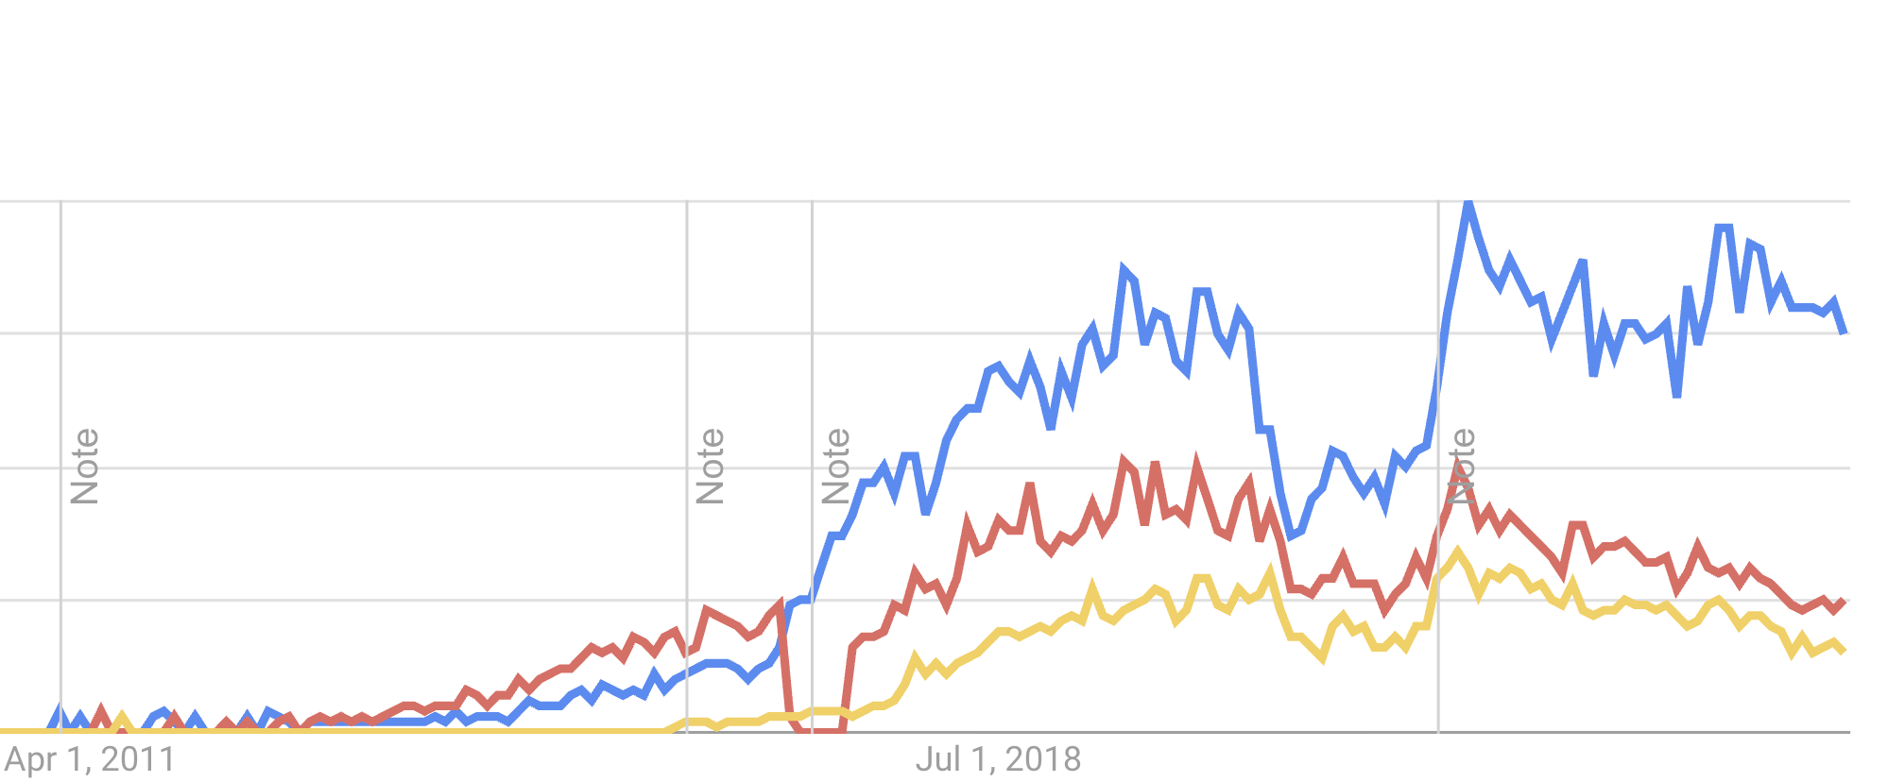
React vs Vue vs Angular

Slide 12
Single Page Application
We don’t refresh the entire page, normally will only have one html which is index.html and all the others are JS files.
Three main technology: Angular, ReactJs and VueJS
Angular | ReactJS | VueJS
By Google | By Facebook
Full Framework Include HTTP call | Library -Have to use JS method of calling HTTP | Library -Have to use JS method of calling HTTP
Bidirectional (will see tomorrow) | Unidirectional | Unidirectional
Two way data binding | One way data binding | One way data binding
Moderate | Hard | Easy - might even replace Jquery
 | Next.js (https://nextjs.org/) | Laravel + VueJS (https://inertiajs.com/) , Nuxt.js (https://nuxt.com/)

Slide 13

Difference between library & Framework
 | Angular | React | Vue
UI Library | Imperative (how to do ) | Declarative (what to do) , (map, reduce, filter) | Imperative (how to do )
HTTP Request | Built in HTTP Module/library | JS fetch axios | JS Fetch axios
Routing | Built in Angular Router | React-Router | Vue-Router
FIle structure | Complex | Simple (we can define how to do) | Simple (we can define how to do)
https://developer.mozilla.org/my/

Slide 14
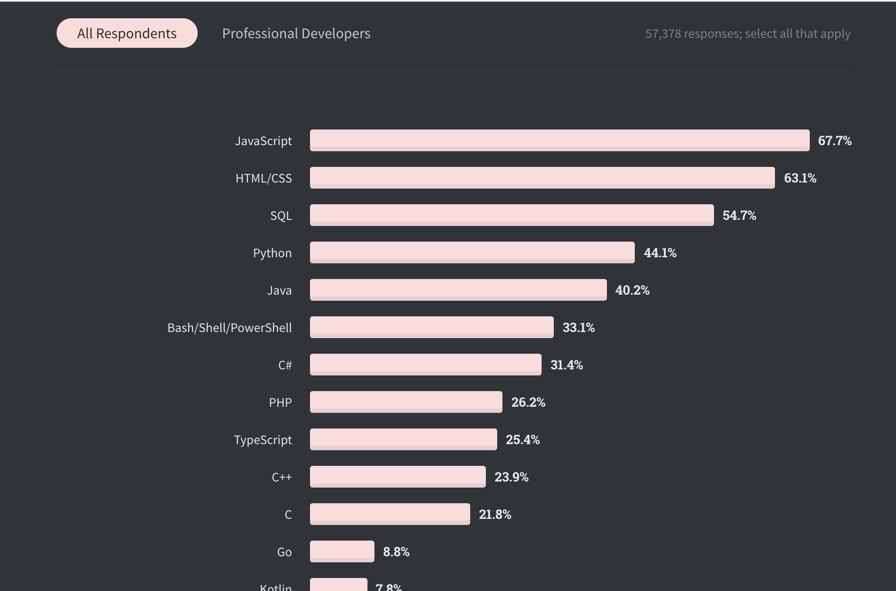

Slide 15
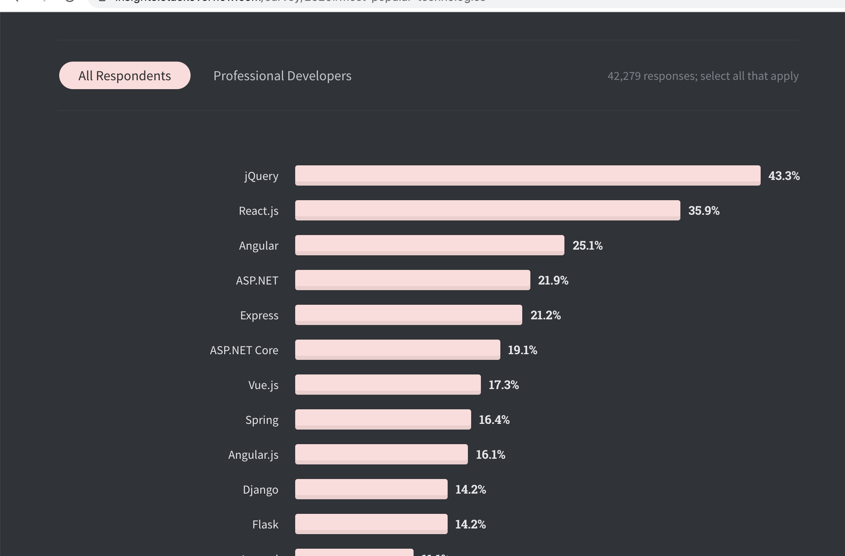

Slide 16
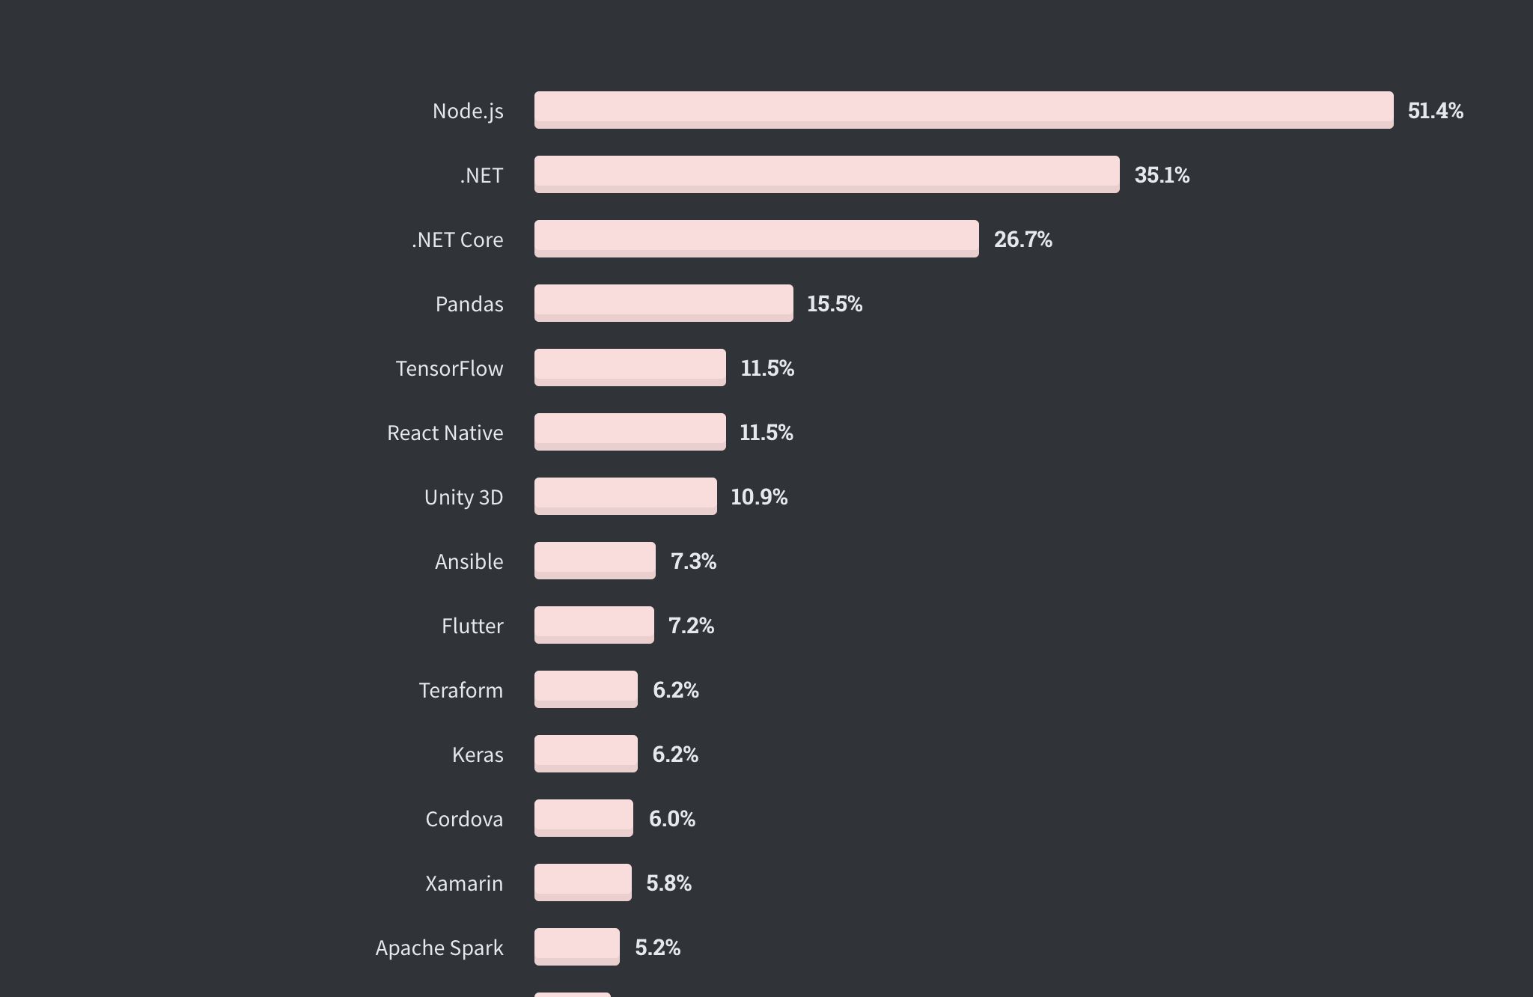

Slide 17
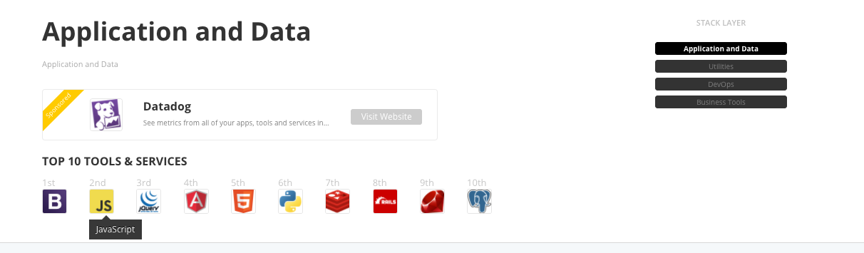

Slide 18
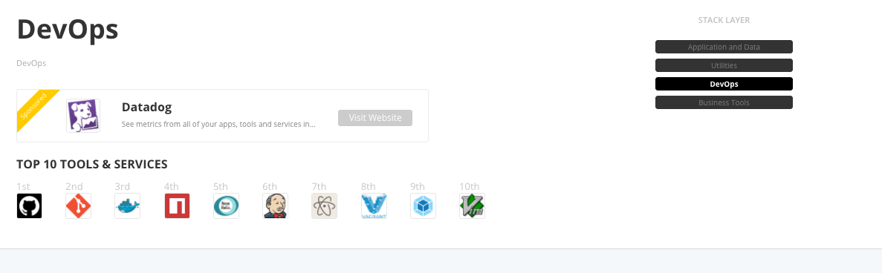

Slide 19

LAMP Stack

Slide 20
ANGULAR KEY FEATURES
ANGULAR - INTRODUCTION TO ANGULAR PRINCIPAL
Full Framework
View
Model
Services
Routing
Http Requests
Easy to use
Scalable
Fast
Animations

Slide 21
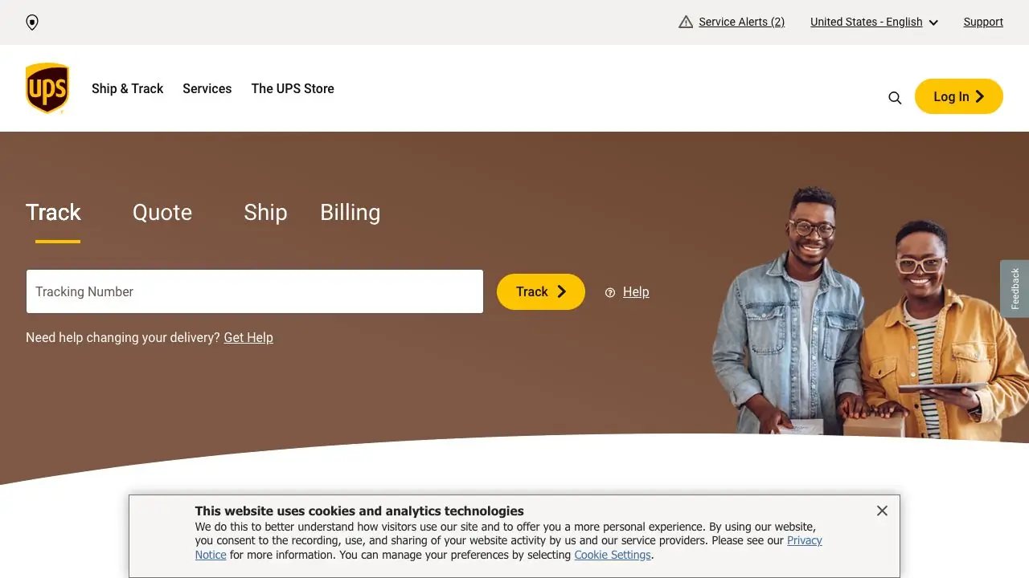
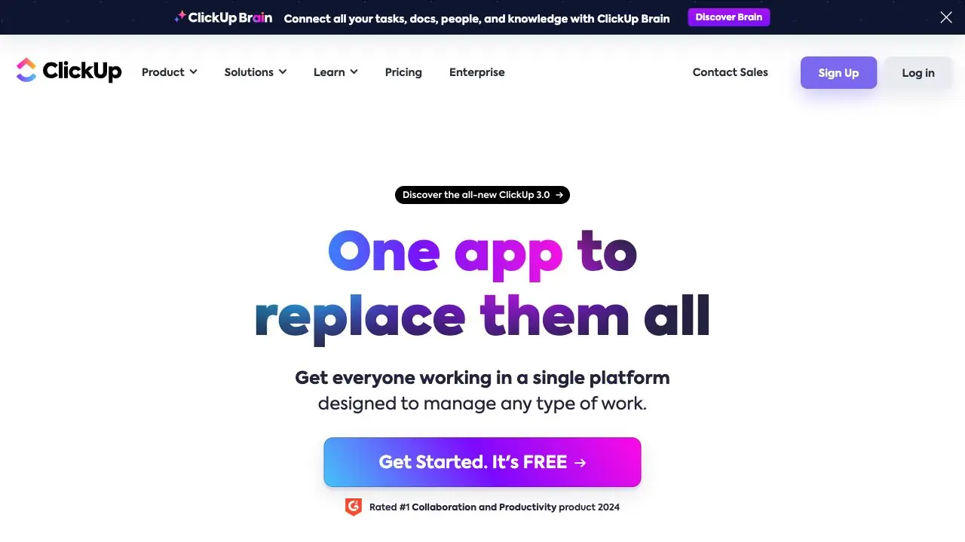


Who uses Angular?
https://www.madewithangular.com/sites/

Slide 22
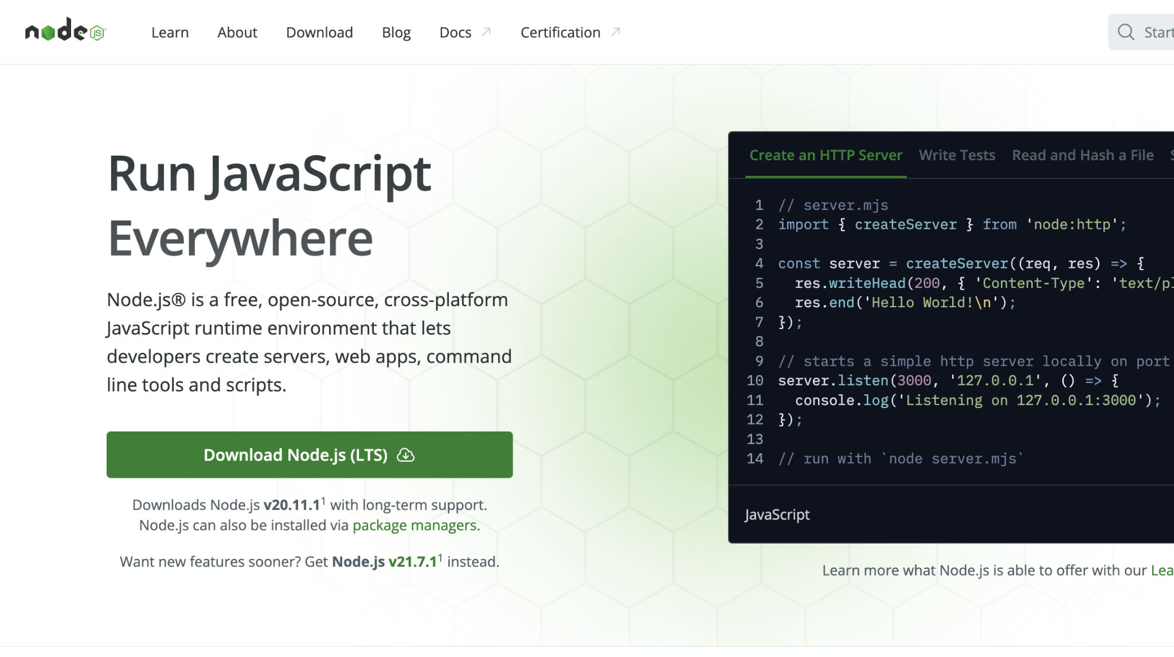
INSTALLATION AND GET STARTED
https://nodejs.org/en
ANGULAR - INTRODUCTION TO ANGULAR PRINCIPAL

Slide 23
INSTALLATION AND GET STARTED
ANGULAR - INTRODUCTION TO ANGULAR PRINCIPAL
Installing Angular
npm install -g @angular/cli (you might need sudo if you are on mac)
Creating new Angular project
ng new hello-world
Open in browser
cd hello-world
ng serve --open

Slide 24
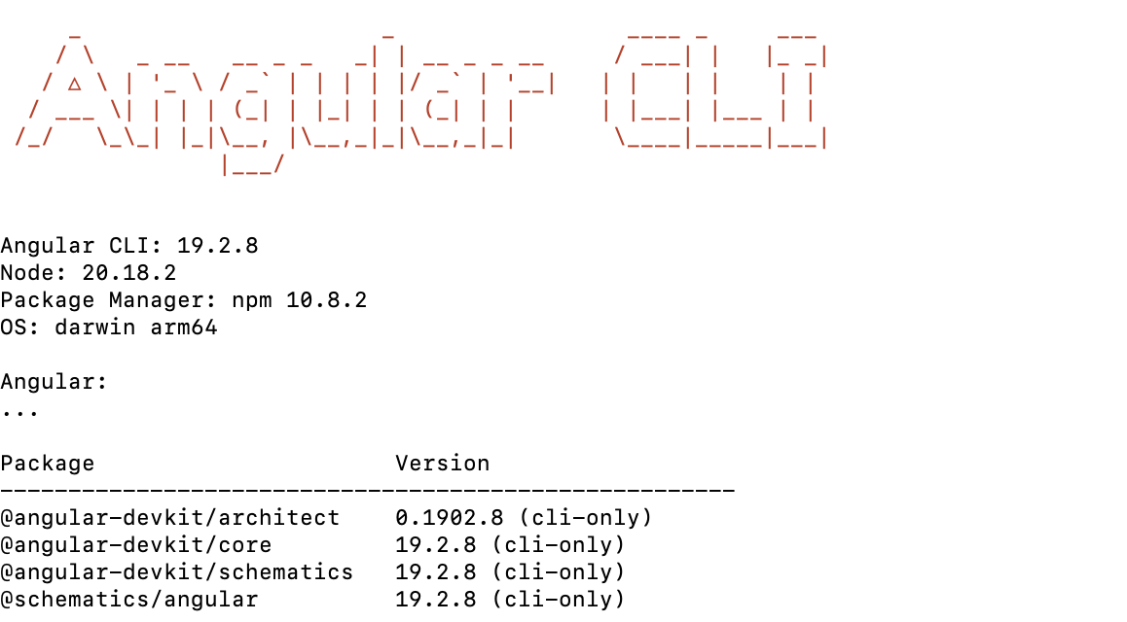
Verify your Angular version
ANGULAR - INTRODUCTION TO ANGULAR PRINCIPAL
ng --version
ng version

Slide 25
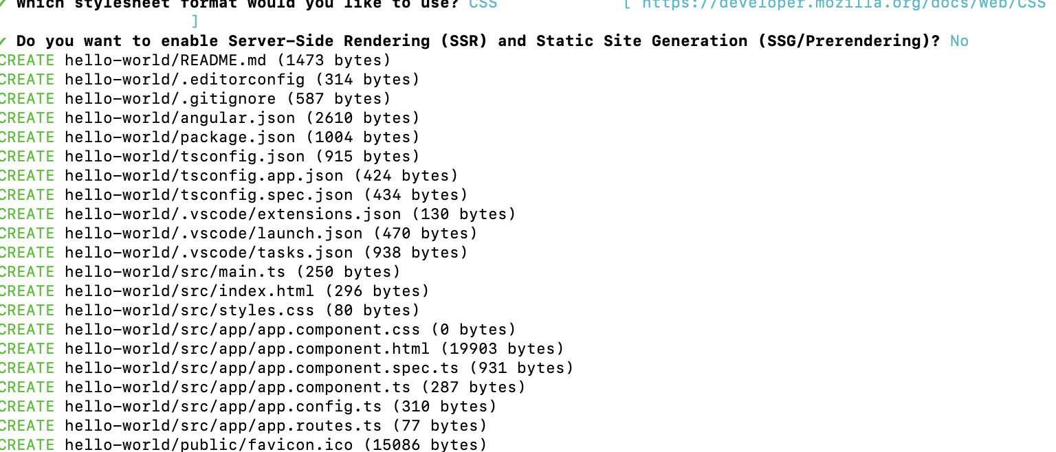

Slide 26
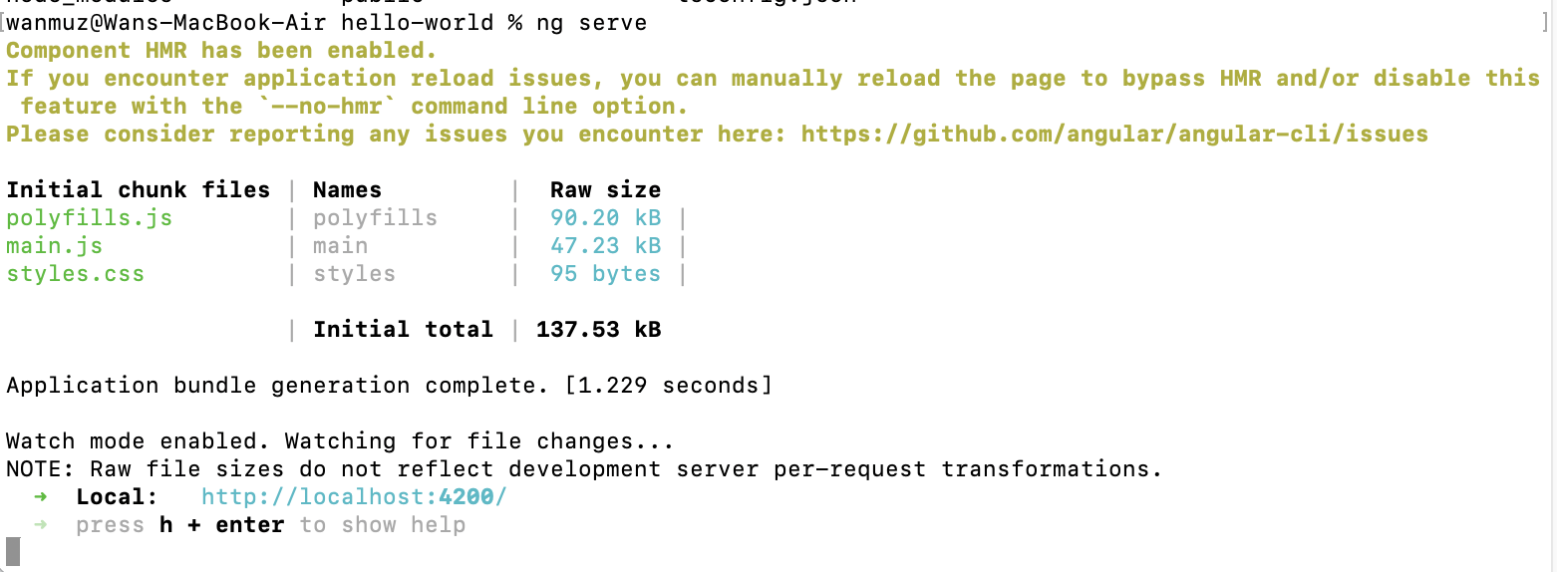

Slide 27
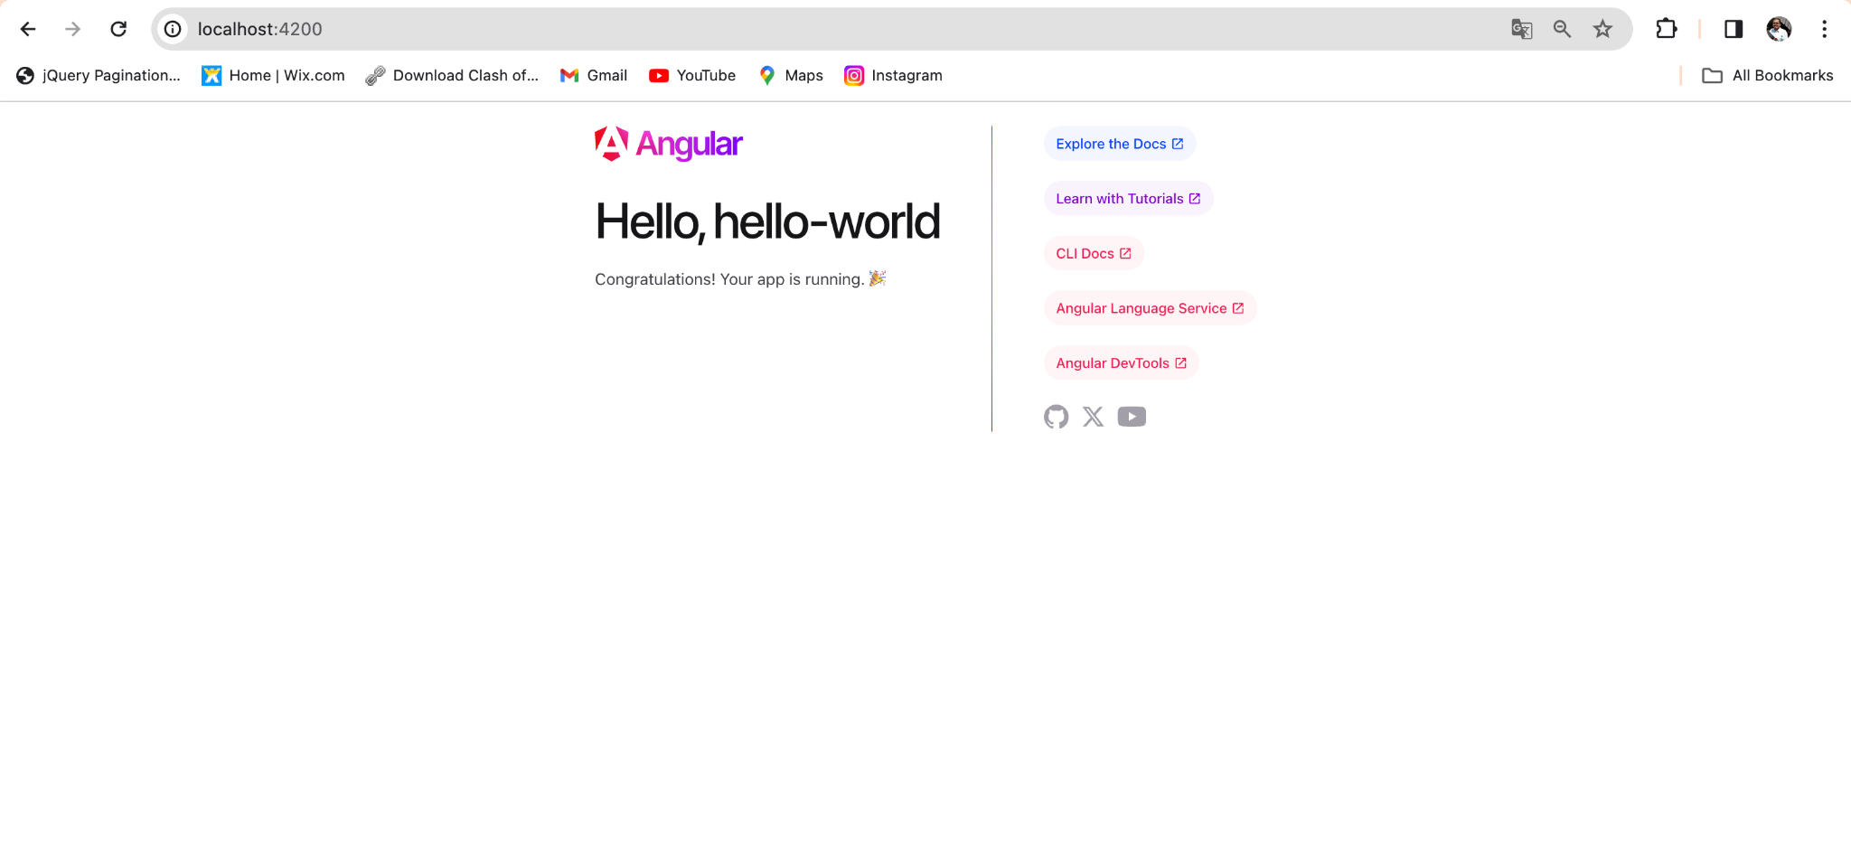
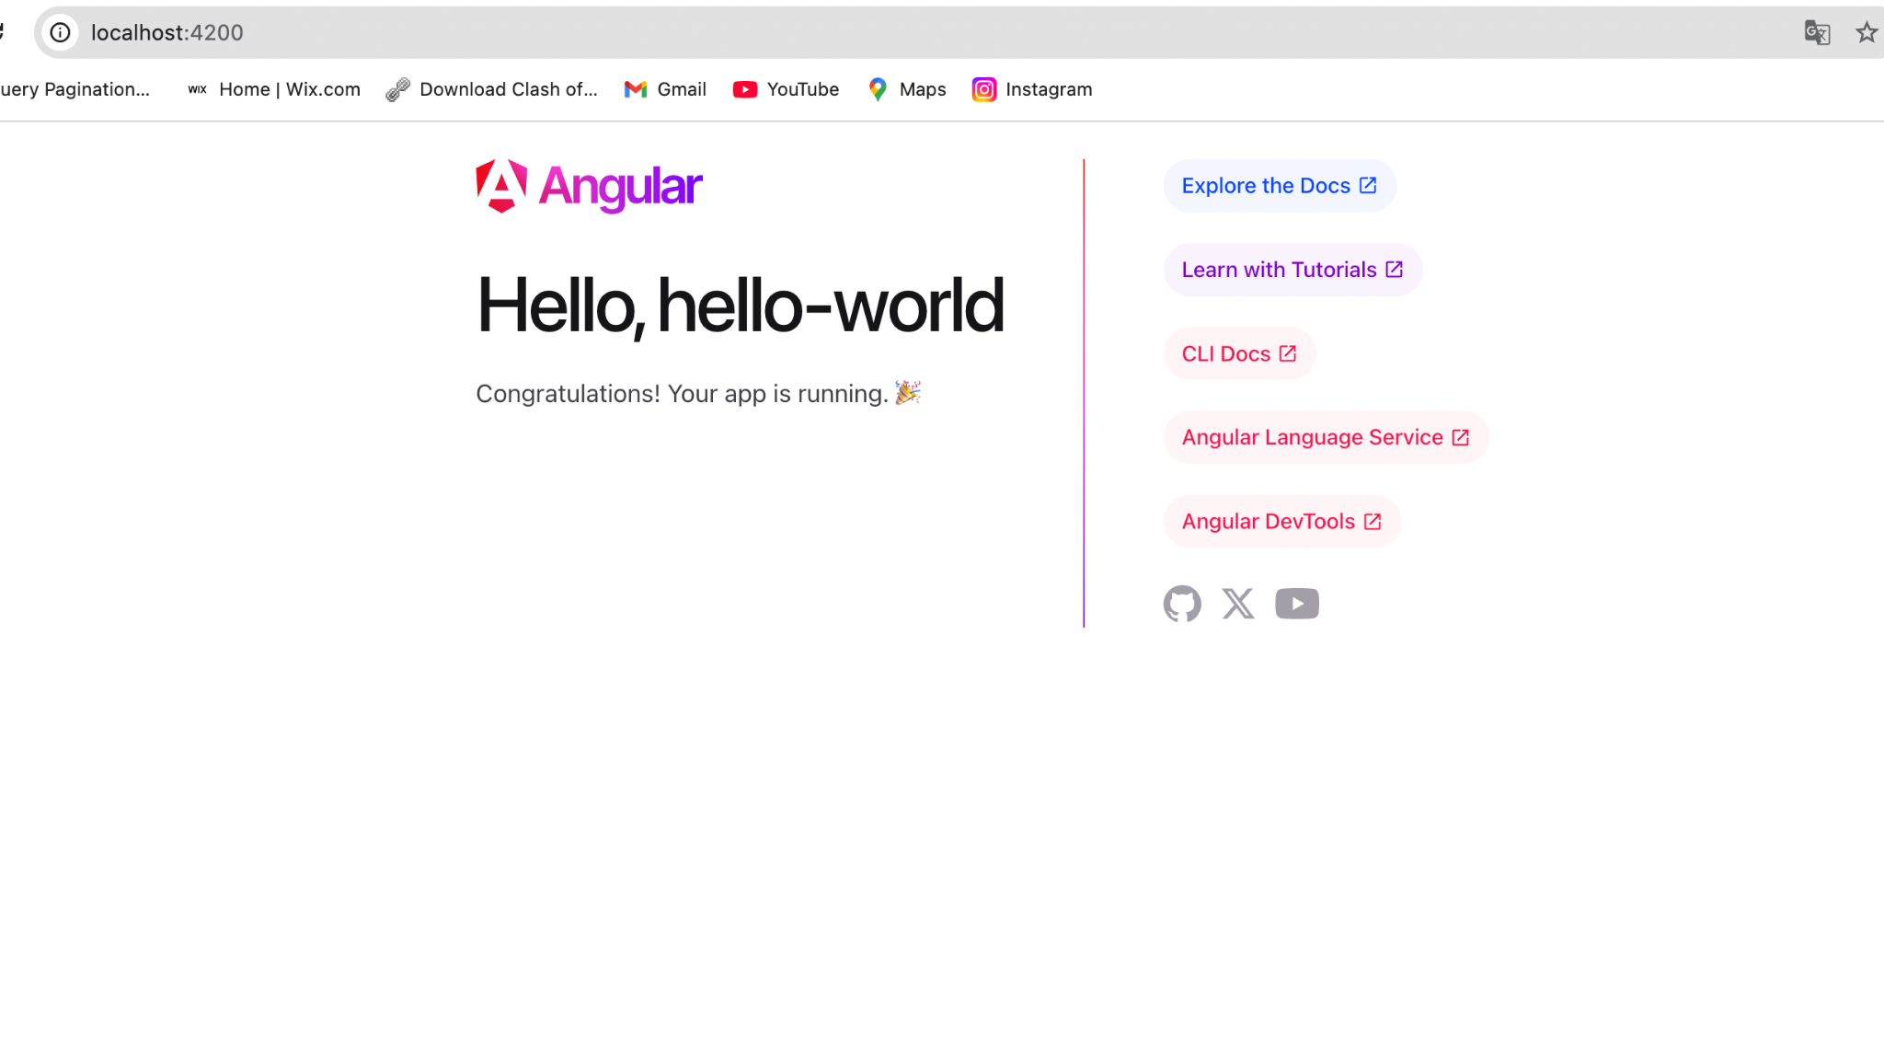

Slide 28
Open the project
Open Visual Studio Code
Select Open Folder
Select the folder angular-training/hello-world
Press Open Folder
Look for src/app/app-component.html

Slide 29
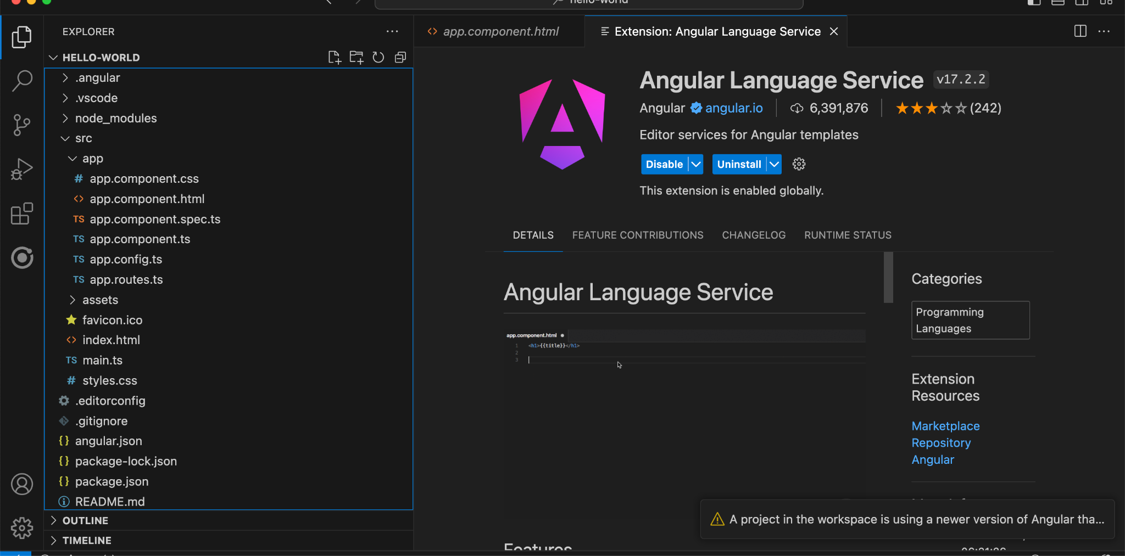
Open project with VS Code
https://code.visualstudio.com/
ANGULAR - INTRODUCTION TO ANGULAR PRINCIPAL

Slide 30
Angular folder structure
ANGULAR - INTRODUCTION TO ANGULAR PRINCIPAL
.vscode: Includes VS Code configuration files
•node_modules: Includes npm packages needed for development and running the Angular application
•src: Contains the source files of the application
• .editorconfig: Defines coding styles for your editor
• .gitignore: Specifies files and folders that Git should not track
• angular.json: The main configuration file of the Angular CLI workspace
• package.json and package-lock.json: Provide definitions of npm packages, along with their exact versions, which are needed to develop, test, and run the Angular application
• README.md: A README file that is automatically generated from the Angular CLI
• tsconfig.app.json: TypeScript configuration that is specific to the Angular application
• tsconfig.json: TypeScript configuration that is specific to the Angular CLI workspace
• tsconfig.spec.json: TypeScript configuration that is specific to unit tests

Slide 31
Angular folder structure(2)
app: Contains all the Angular-related files of the application. You interact with this folder most of the time during development.
•assets: Contains static assets such as fonts, images, and icons.
• favicon.ico: The icon displayed in the tab of your browser, along with the page title.
• index.html: The main HTML page of the Angular application.
• main.ts: The main entry point of the Angular application.
•styles.css: Contains application-wide styles. These are CSS styles that apply globally to the Angular application. The extension of this file depends on the stylesheet format you choose when creating the application.

Slide 32
Sample code in Angular
app.component.css: Contains CSS styles specific for the sample page
• app.component.html: Contains the HTML content of the sample page
•app.component.spec.ts: Contains unit tests for the sample page
•app.component.ts: Defines the presentational logic of the sample page
•app.module.ts: Defines the main module of the Angular application

Slide 33
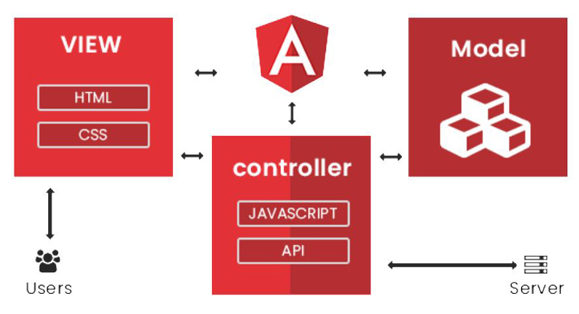
MVC in Angular
ANGULAR - INTRODUCTION TO ANGULAR PRINCIPAL

Slide 34
Component in Angular
Files prefixed with app.component define an Angular component.
In Angular, a component is responsible for controlling a specific part of the web page by linking presentation logic (written in TypeScript) with the HTML template that defines the view.
Every Angular application has at least one root component, conventionally named AppComponent, which serves as the main entry point for rendering content on the page.

Slide 35
index.html
Every Angular application includes a main HTML file named index.html, located in the src folder. This file contains the following <body> element:
The custom <app-root> tag represents the root component of the Angular application (typically AppComponent). It acts as a placeholder where Angular dynamically renders the template and logic of the root component. This is the starting point of the application’s UI.
<body>
<app-root></app-root>
</body>

Slide 36
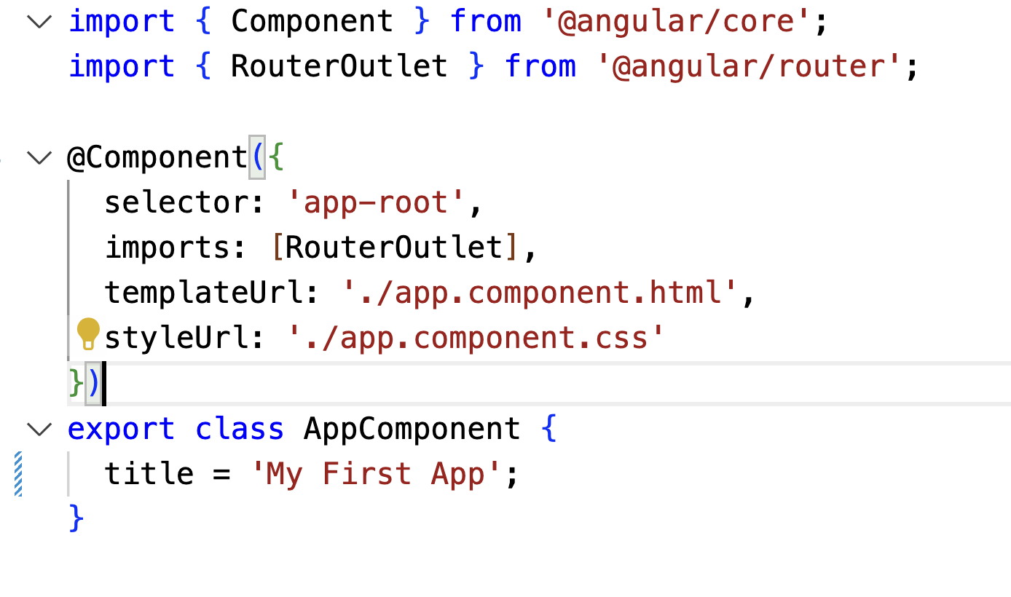
Hello World
Go to app.component.ts and change the title to ‘My First app’

Slide 37
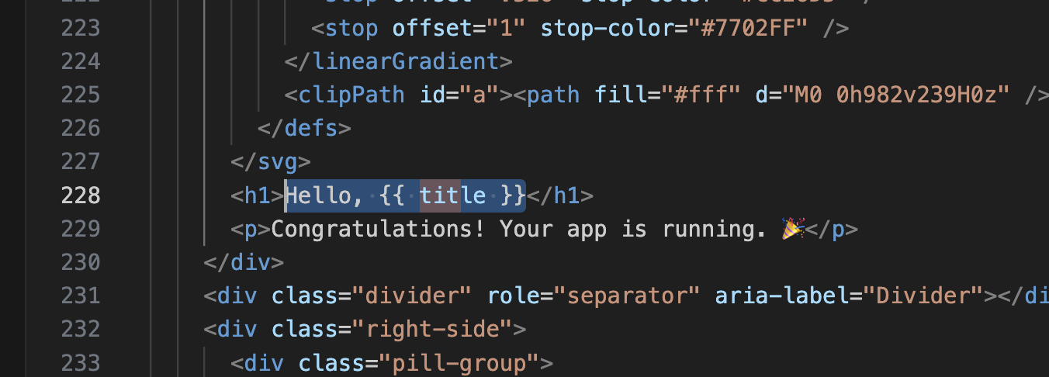
Hello World
Open app.component.html and verify in line 228

Slide 38
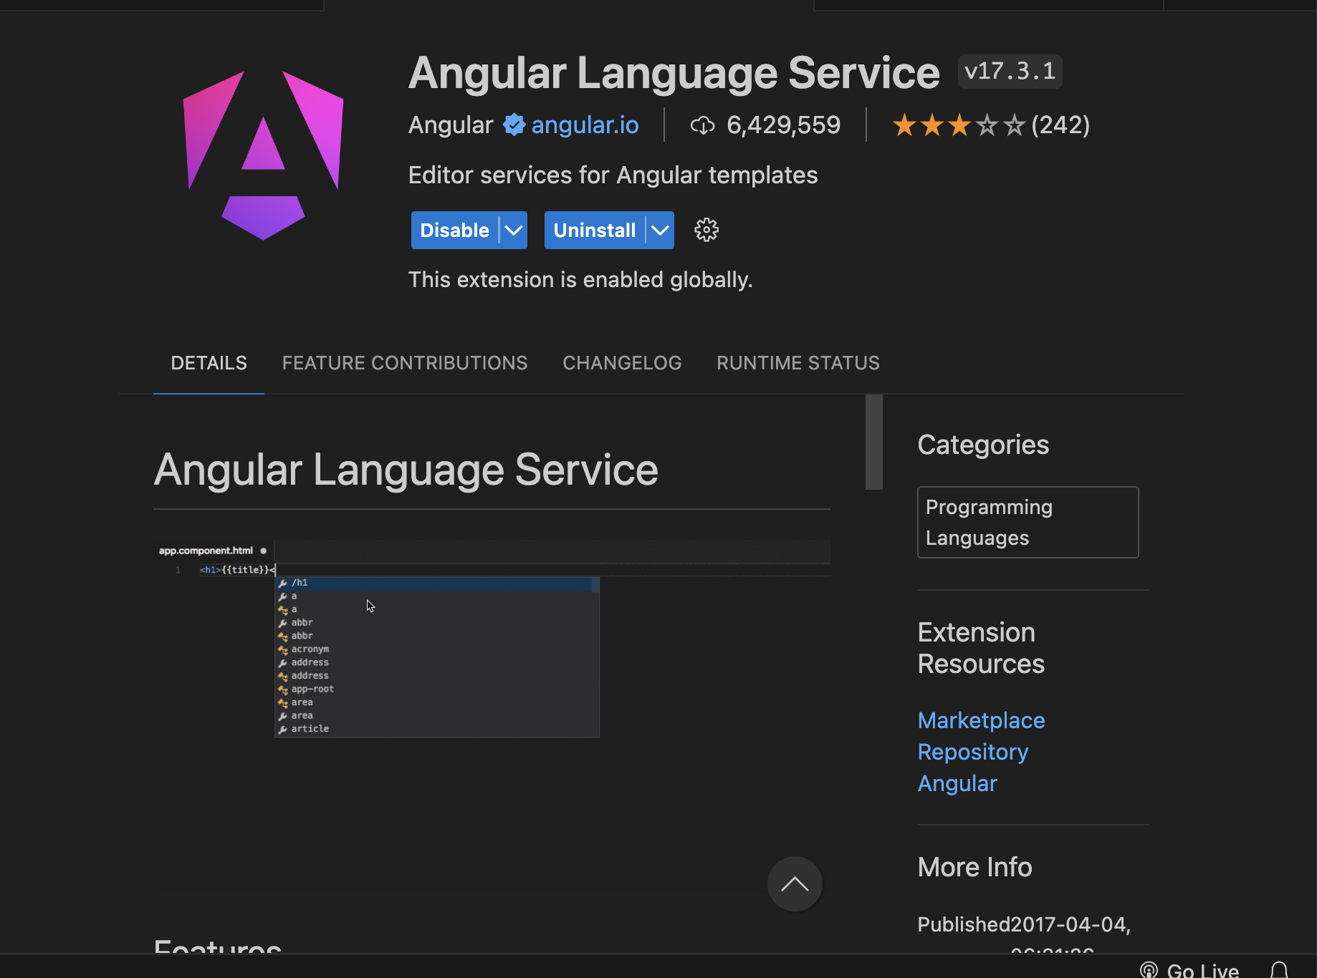
Angular Extension

Slide 39
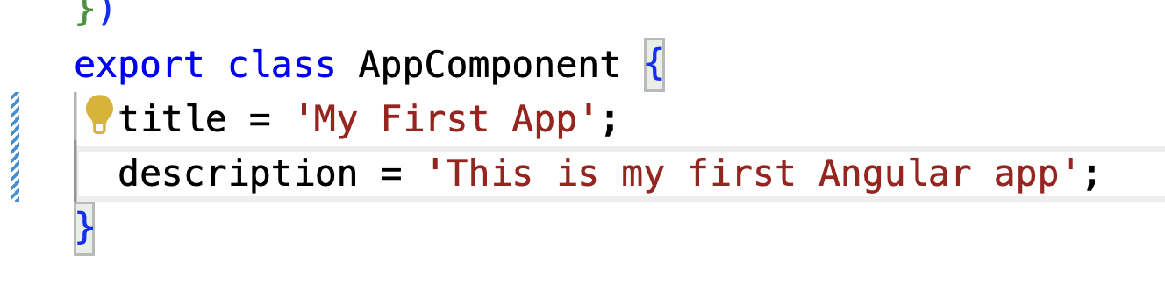
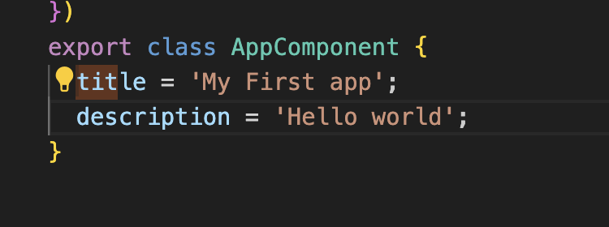
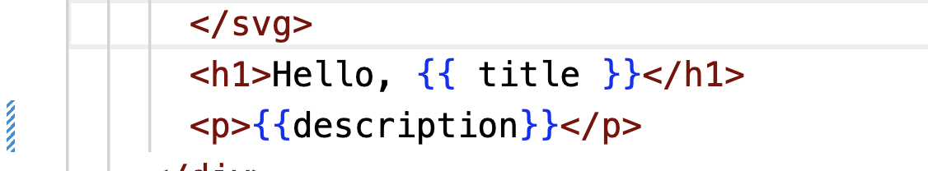
Discover autocorrect VSCode
Add the following in app.component.ts
In app.component.html verify the autocorrect:

Slide 40
Angular Modules
Angular modules are containers for a particular block of code that adheres to the same functionality.
An Angular module is dedicated to an application domain, such as orders or customers for an e-shop application, or a user workflow, such as order checkout or user registration.
Generally, it addresses a particular set of capabilities that an application can have.
The main advantage of the Angular module architecture is that it scales better and is easier to test.

Slide 41
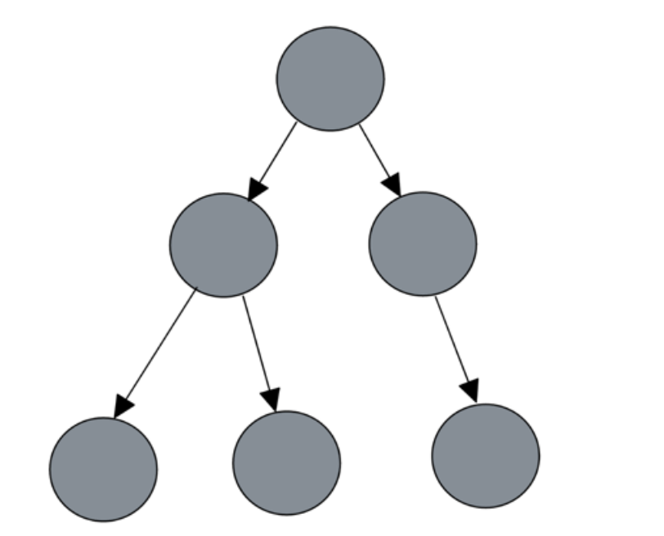
Component
ANGULAR - INTRODUCTION TO ANGULAR
Components are the fundamental building blocks of an Angular application.
Each component controls a specific part of the user interface, known as a view — for example, a product list, navigation bar, or checkout form.
Components handle the presentational logic, connecting the application's data with its visual structure via templates.
Angular organizes components in a hierarchical tree structure, allowing parent and child components to interact through inputs, outputs, and services, enabling modular and scalable application design.

Slide 42
Structure of an Angular Component
In Angular, the @Component decorator is used to define and configure a component. It includes several key metadata properties:
selector: A CSS selector that tells Angular where to insert the component in the DOM. Angular looks for a matching HTML tag and renders the component at that location.
templateUrl: Specifies the path to an external HTML file that contains the component’s template. Alternatively, you can use the template property to define the HTML inline.
styleUrls: An array of paths pointing to external CSS files used for styling the component. Alternatively, you can use the styles property to define styles inline.

Slide 43
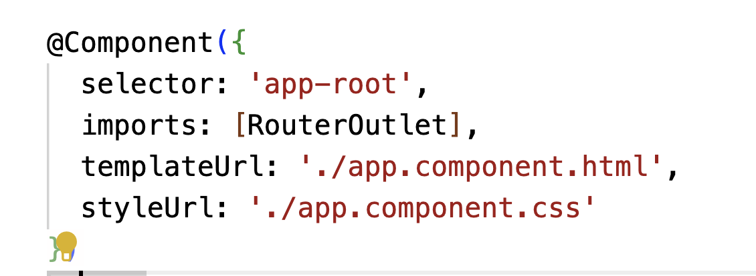
Structure of an Angular Component

Slide 44
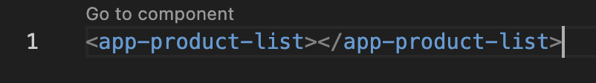
GENERATING NEW COMPONENT
ANGULAR - INTRODUCTION TO ANGULAR PRINCIPAL
Generate new component
ng g component product-list --standalone
ng g component header --standalone
ng g component footer --standalone
Call the component in app.component.html
Add the component as an import in app.component.ts

Slide 45
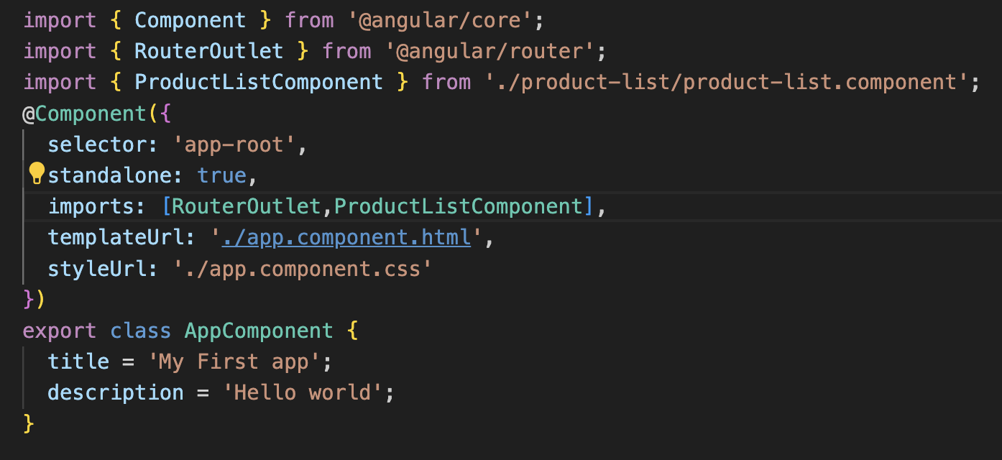
Importing the component in app.component.ts

Slide 46
Create the following structure
Header
<app-header></app-header>
ProductList
<app-product-list></app-product-list>
ProductDetail
<app-product-detail></app-product-detail>
Footer
<app-footer></app-footer>

Slide 47
String interpolation
Interpolation in Angular is a technique to bind component data to the HTML template using double curly braces ({{ ... }}).
It allows you to display dynamic values (e.g., strings, numbers, expressions) in the UI.
<span>{{title}}</span>

Slide 48
Property binding
An alternative way to perform interpolation is to bind the title property to the innerText property of the span HTML element:
<span [innerText]="title"></span>
We bind to the Document Object Model (DOM) property of an element.
The property inside square brackets is called the target property and is the property of the DOM element into which we want to bind.
The variable on the right is called the template expression and corresponds to the title property of the component.

Slide 49
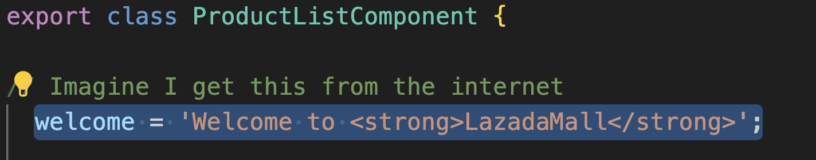
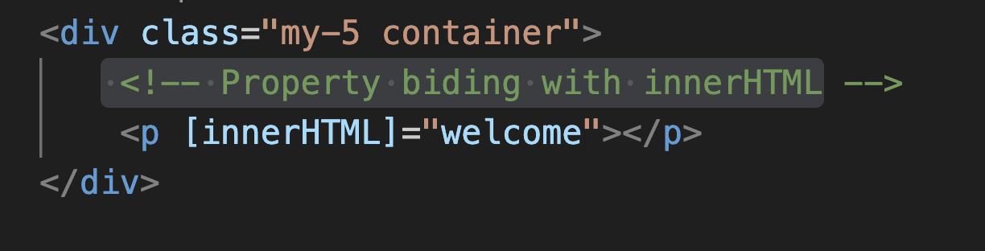
Example in class [innerHTML]
product-list.component.ts
product-list.component.html

Slide 50
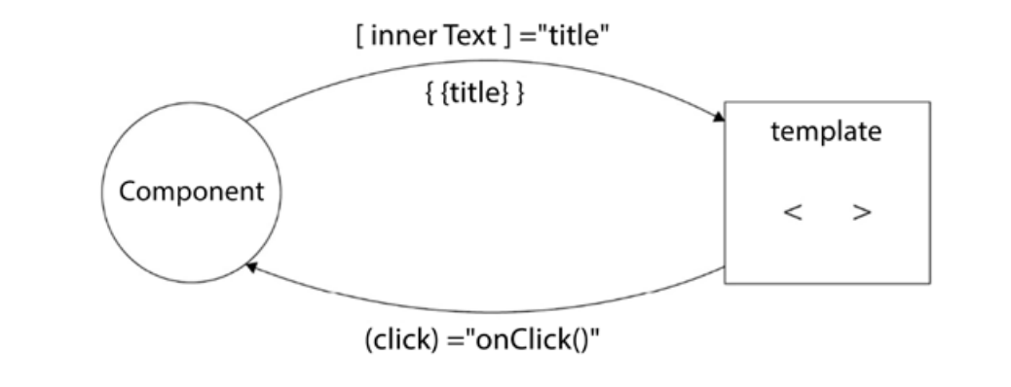
Event Binding in Angular
Event Binding is a technique to get data from the template back to the component class.
An event binding listens for DOM events on the target HTML element and responds to those events by calling corresponding methods in the component class.
Event binding in Angular supports all native DOM events found at https://developer.mozilla.org/docs/Web/Events.

Slide 51
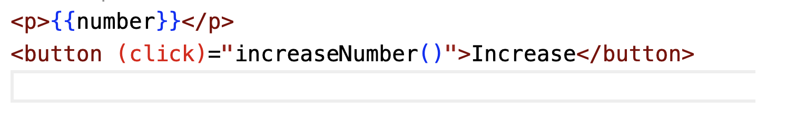
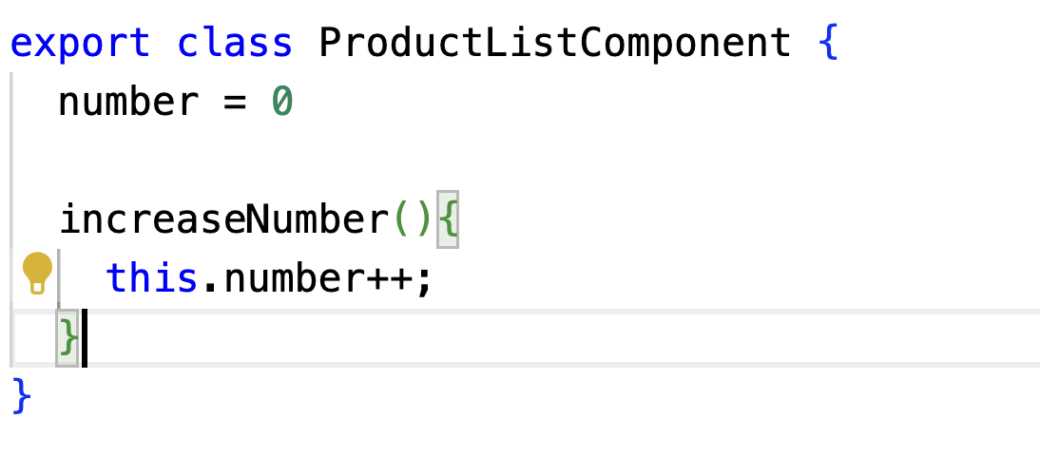
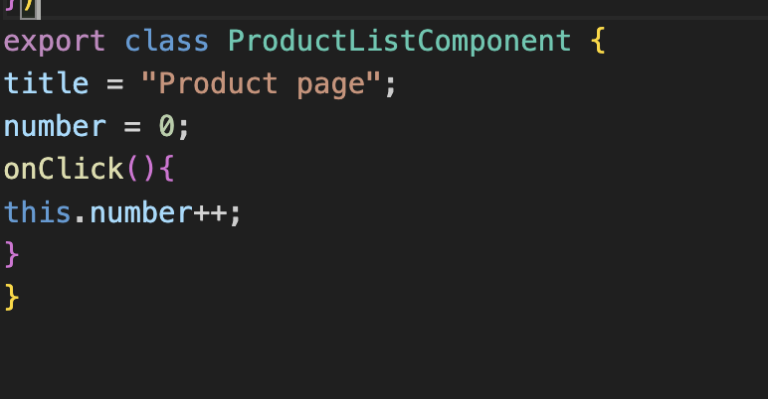
Example of Event Binding
.html
.ts

Slide 52
Control Flow in Components - @if
Introduced in Angular 17+ as part of the control flow syntax improvements
Replaces the traditional *ngIf structural directive with a more readable and explicit syntax
Enables block-level conditional rendering using @if and @else
Better IDE support, type checking, and developer experience
Works inside component templates (inline or external)

Slide 53
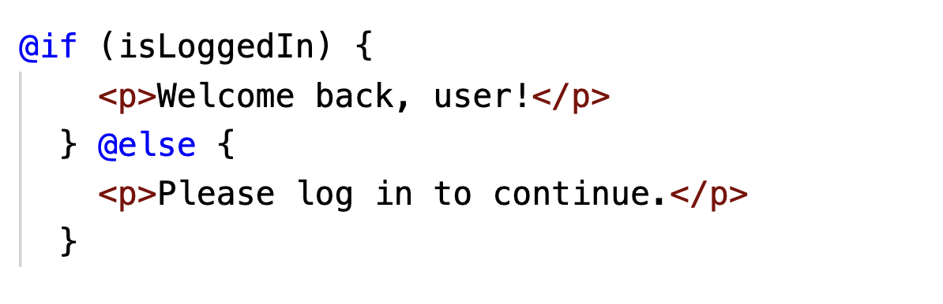
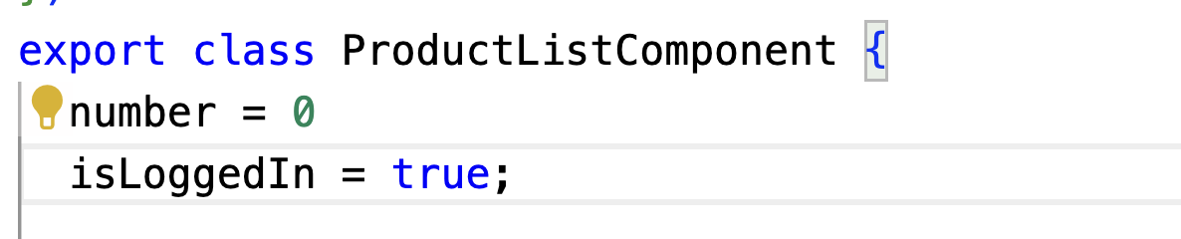
Sample code
.html
.
ts

Slide 54
Control Flow in Components: @for
Introduced as a modern replacement for *ngFor Provides a clearer and block-scoped syntax for iterating over lists
Supports destructuring, index, first, last, even, odd, and track by functionality
Offers better readability, stronger typing, and improved tooling support Ideal for simplifying nested loops and complex list rendering

Slide 55
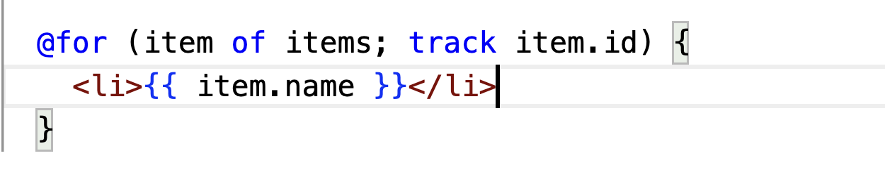
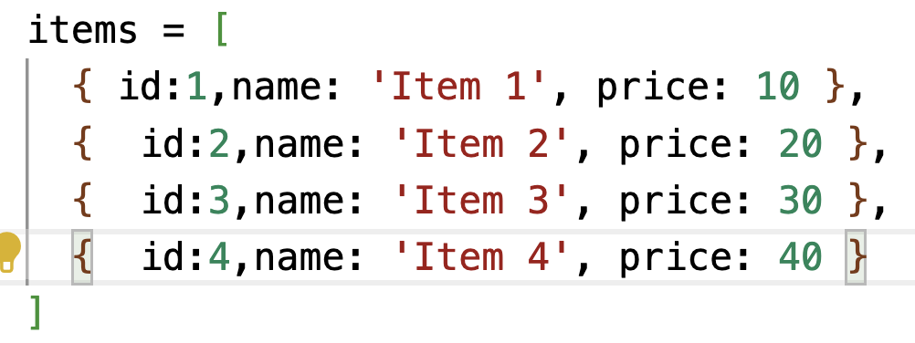
Sample code
.html
.
ts

Slide 56
@switch and @case
New template control flow syntax introduced in Angular 17+ (stable in Angular 19).
Alternative to *ngSwitch directive.
Designed for cleaner, declarative, and more readable code in templates.

Slide 57
Code Example
@switch (user.role) {
@case ('admin') {
<p>Welcome, Admin!</p>
}
@case ('editor') {
<p>Hello, Editor!</p>
}
@default {
<p>Access limited.</p>
}
}

Slide 58
Component Inter-communication
Angular components expose a public API that allows them to communicate with other components.
This API encompasses input properties, which we use to feed the component with data.
It also exposes output properties we can bind event listeners to, thereby getting timely information about changes in the state of the component.

Slide 59
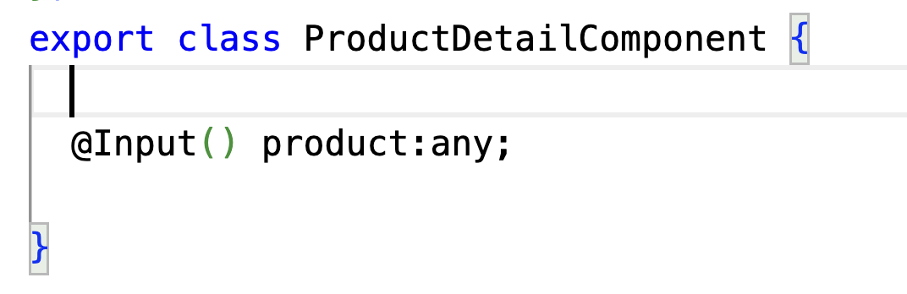
Component Inter-Communication
Add a new component , product-detail:
ng generate component product-detail
Inside product-detail.component.ts add @Input

Slide 60
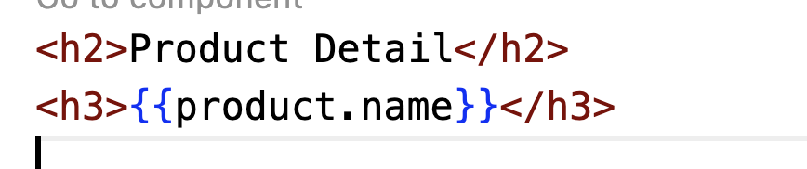
Component Inter-Communication (2)
Inside product-detail.component.html bring out the name

Slide 61
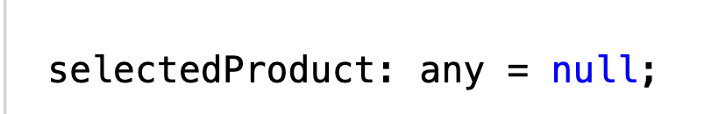
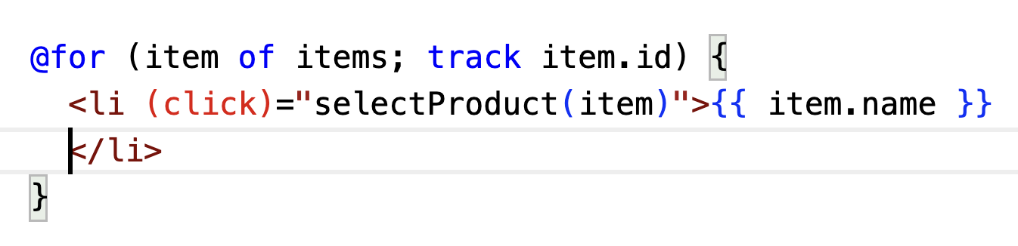
Component Inter-Communication (2)
Add new variable selectedProduct inside product-list.component.ts
Create the product list in product-list.component.html

Slide 62
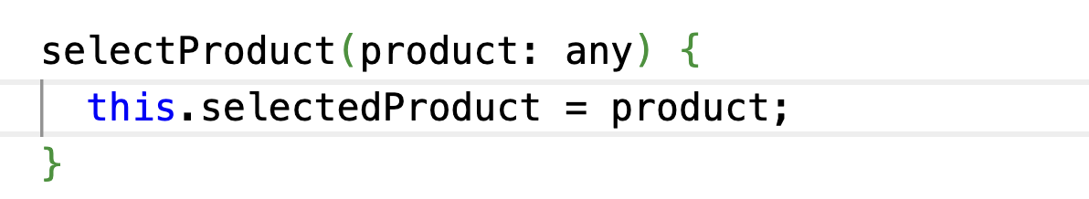
Component Inter-Communication (3)
Create selectProduct method in product-list.component.ts

Slide 63
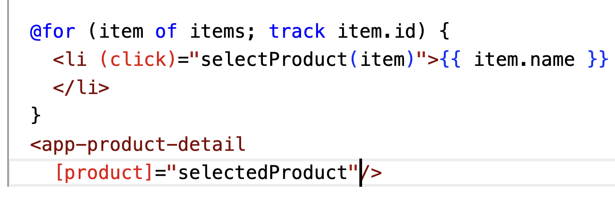
Component Inter-Communication (4)
Pass the selectedProduct to the ProductDetail component . This approach is called input binding.

Slide 64
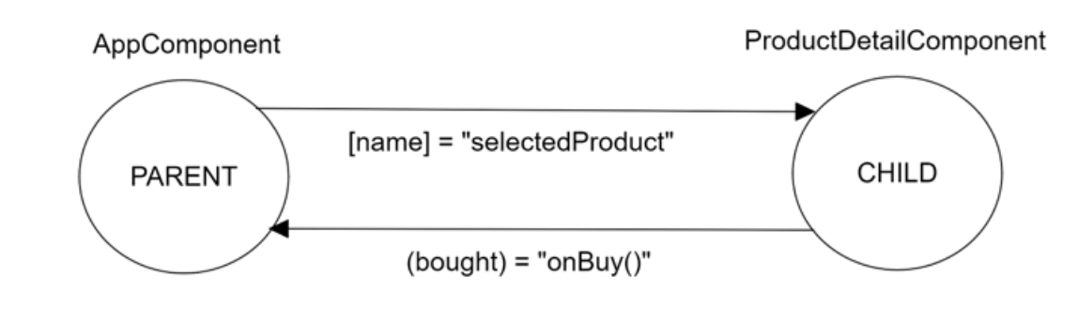
Listening for events on output binding
We use an output directive to notify the parent component about specific actions that occur in the child component.
In this example we will add a button “Buy Now” on the child component and notify the parent component of this event .

Slide 65
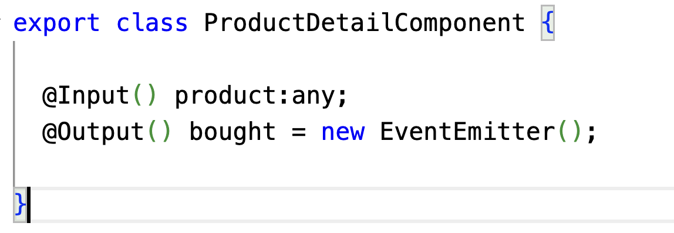
Listening for events on output binding
In product-detail.component.ts, import the following:
Add an @Output directive with an EventEmitter object:

Slide 66
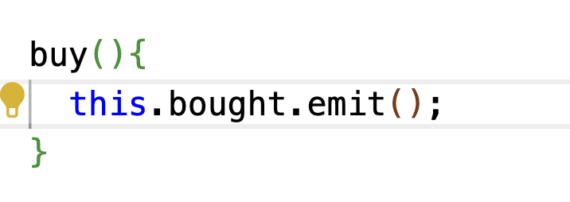
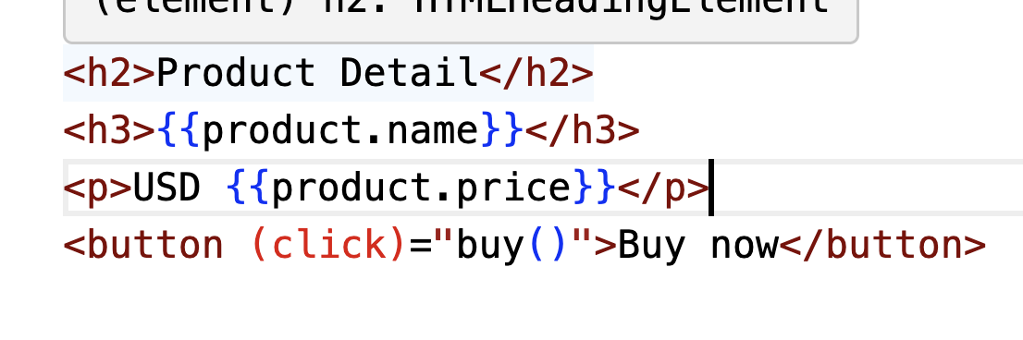
Listening for events on output binding
In product-detail.component.ts, implement the method buy :
Add a button that will be linked to the method buy in product.component.html

Slide 67


Listening for events on output binding
Modify the selector on product-list.component.html
Implement the method onBuy in product-list.component.ts

Slide 68


Emitting data through custom event
The emit method of an EventEmitter property can accept any data to pass up to the parent component. The proper way is initially to define the data type that can be passed to the EventEmitter property.
product-detail.component.ts

Slide 69


Emitting data through custom event
product-list.component.html
product-list.component.ts

Slide 70
Introduction to component lifecycle
Lifecycle events are hooks that allow us to jump into specific stages in the lifecycle of a component and apply custom logic
Some hooks are considered best practices, while others help debug and understand what happens in an Angular application. A hook comes with an interface that defines a method we need to implement. The Angular framework ensures the hook is called, provided we have implemented this method in the component.

Slide 71
Component Lifecycle
The most basic lifecycle hooks of an Angular component are:
•OnInit: This is called when a component is initialized
•OnDestroy: This is called when a component is destroyed
•OnChanges: This is called when values of input binding properties in the component change
• AfterViewInit: This is called when Angular initializes the view of the current component and its child components
A full list of all the supported lifecycle hooks is available in the official Angular documentation at https://angular.dev/guide/components/lifecycle

Slide 72
Performing component initialization
The OnInit lifecycle hook implements the ngOnInit method, which is called during the component initialization. At this stage, all input bindings and data-bound properties have been set appropriately, and we can safely use them.
Using the component constructor to access them may be tempting, but their values would not have been set at that point
Constructors should be relatively empty and devoid of logic other than setting initial variables.

Slide 73

Performing component initialization

Slide 74
Performing component initialization

Slide 75
Detecting input binding change
The OnChanges lifecycle hook is called when Angular detects that the value of an input data binding has changed.
In our example, we will use it in the product detail component to learn how it behaves when we select a different product from the list:

Slide 76

Detecting input binding change
product-detail.component.ts

Slide 77
Directives
Angular directives are HTML attributes that extend the behavior or the appearance of a standard HTML element. When we apply a directive to an HTML element or even an Angular component, we can add custom behavior to it or alter its appearance.
There are three types of directives:
•Components: They are directives with an associated template
•Structural directives: They add or remove elements from the DOM
• Attribute directives: They modify the appearance of or define a custom behavior for a
DOM element

Slide 78
Transforming elements using
directives
Angular framework includes a set of ready-made structural directives that we can start using straight away in our applications:
ngIf: Adds or removes a portion of the DOM tree based on an expression
ngFor: Iterates through a list of items and binds each item to a template
ngSwitch: Switches between templates within a specific set and displays each one depending on a condition

Slide 79
Displaying data conditionally
The ngIf directive adds or removes an HTML element in the DOM based on the evaluation of an expression. If the expression evaluates to true, the element is inserted into the DOM. Otherwise, the element is removed from the DOM.
We can use a <ng-template> element to compose an if-else statement in the template of our component

Slide 80

CommonModule
To use built-in directive or pipes, you need to Import CommonModule in component:

Slide 81


Displaying data conditionally
product-list.component.ts
product-list.component.html

Slide 82

Displaying data conditionally
product-list.component.html

Slide 83
Iterating through data
The ngFor directive allows us to loop through a collection of items and render a template for each one, where we can define convenient placeholders to interpolate item data.
Each rendered template is scoped to the outer context, where the loop directive is placed so that we can access other bindings.
We can think of ngFor as the for loop for HTML templates.

Slide 84


Iterating through data (3)
product-list.component.ts
product-list.component.html

Slide 85
Iterating through data (4)
The variable is a template input variable that we can reference later in our template. The property can have the following values:
• index: Indicates the index of the item in the array, starting at 0 (number)
• first/last: Indicates whether the current item is the first or last item in the array (boolean)
• even/odd: Indicates whether the index of the item in the array is even or odd (Boolean)

Slide 86
Iterating through data (5)
<div>
<ul>
<li *ngFor="let product of products; let i = index" >
{{i+1}} - {{product}}
</li>
</ul>
</div>

Slide 87
Iterating through data (6)
During the execution of ngFor, data may change, elements may be added or removed, and the whole list may even be replaced. Angular must take care of these changes by creating/removing elements to sync changes to the DOM tree. This is a process that can become very slow and expensive and will eventually result in the poor performance of your application.
Angular deals with variations within a collection by keeping DOM elements in memory. Internally,it uses something called object identity to keep track of every item in a collection. We can, how ever, use a specific property of the iterable items instead of the internal Angular object identity using the trackBy property:

Slide 88


Iterating through data (7)

Slide 89
Switching through templates
ngSwitch is used to switch between templates and display each one depending on a defined value.
It is like an ordinary switch statement that we use in other programming languages, consists of a set of other directives:
[ngSwitch]: Defines the property that we want to check when applying the directive
• *ngSwitchCase: Adds or removes a template from the DOM tree depending on the value of the property defined in the [ngSwitch] statement
• *ngSwitchDefault: Adds a template to the DOM tree if the value of the property definedin the [ngSwitch] directive does not meet any *ngSwitchCase statement

Slide 90

Switching through templates

Slide 91
Manipulating data with pipes
Pipes allow us to transform the outcome of our expressions at the view level. They take data as input, transform it into the desired format, and display the output in the template.
The syntax of a pipe is pretty simple, consisting of the pipe name following the expression we want to transform, separated by a pipe symbol (|).
Pipes are usually used with interpolation in Angular templates and can be chained to each other.
Angular has a wide range of pipe types already baked into it.
https://angular.io/guide/pipes

Slide 92

Creating product interface
ng g interface product
product.ts

Slide 93

Creating array of products
In product-list.component.ts replace products to array of Product. Verify in the project to take Product type instead of string.

Slide 94
Manipulating data with pipes
uppercase/lowercase: They transform a string into a particular case.
{{product.name | uppercase}}
{{product.name | lowercase}}
percent: This formats a number as a percentage. For example, the output of <p>{{0.1234 | percent}}</p> will be 12%.
• currency: This formats a number as a local currency. We can override local settings and change the symbol of the currency, passing the currency code as a parameter to the pipe.
{{product.price | currency:'USD'}}

Slide 95
Manipulating data with pipes
slice:This subtracts a subset (slice) of a collection or string. It accepts a starting index,
where it will begin slicing the input data, and optionally an end index as parameters. When the end index is specified, the item at that index is not included in the resulting array. If the end index is omitted, it falls back to the last index of the data.
<ul> <li *ngFor="let product of products | slice:1:3"> {{product.name}} </li> </ul>

Slide 96
Manipulating data with pipes
date: This formats a date or a string as a particular date format. The time zone of the formatted output is in the local time zone of the end user’s machine. The following snippet displays the component property today as a date:
<p>{{today | date}}</p> <p>{{today | date:'fullDate'}}</p>
https://angular.io/api/common/DatePipe
json: It takes an object as an input and outputs it in JSON format. <p>{{product | json}}</p>

Slide 97
Creating a custom pipe
To create a new pipe, we use the generate command of the Angular CLI, passing the word pipe and its name as parameters:
ng generate pipe sort
If you want to create on a particular folder
ng generate pipe pipes/sort

Slide 98

Creating a custom pipe

Slide 99
Creating a custom pipe
The only required property in the @Pipe decorator is the name of the pipe. A pipe must implement the transform method of the PipeTransform interface that accepts two parameters:
•value: The input data that we want to transform
• args: An optional list of arguments we can provide to the transformation method, each
separated by a colon

Slide 100

Creating a custom pipe

Slide 101
Example in case (using product)
transform(value: string[]): string[] {
if (value){
return value.sort((a:string,b:string)=>{
if (a < b ){
return -1;
} else if (b < a){
return 1
}
return 0
})
}
return [];
}

Slide 102

Creating a custom pipe

Slide 103

Creating a custom pipe

Slide 104
Custom Directive
Custom Directive allow you to attach advanced behaviors to elements in the DOM or modify their appearance.
Directives mainly fall into two categories: structural and attribute.
ng g directive copyright
ng g directive directives/copyright
Reference to DOM manipulation (pure JS) : https://www.w3schools.com/jsref/met_document_createelement.asp

Slide 105

Custom directive

Slide 106

Custom directive

Slide 107
Custom directive
The ElementRef class to access and manipulate the underlying HTML element attached to the directive. The nativeElement property contains the actual native HTML element.
Add the copyright class in styles.css
.copyright {
background-color: lightgray;
padding: 10px;
font-family: Verdana, Geneva, Tahoma, sans-serif;
}

Slide 108

Custom Directive
product.component.html

Slide 109
Property binding and responding to event
The Angular framework provides two helpful decorators that we can use in our directives to enhance their functionality:
@HostBinding: This binds a value to the property of the native host element
@HostListener: This binds to an event of the native host element
A good example on how you can create custom directive:
https://codecraft.tv/courses/angular/custom-directives/hostlistener-and-hostbinding/

Slide 110
Property binding and responding to event(2)
In this example we will create a directive that listens to keypress event from a directive and intercept non numerical value .
ng generate directive numeric

Slide 111
Property binding and responding to event(3)
numeric.directive.ts

Slide 112

Property binding and responding to event(4)
numeric.directive.ts

Slide 113


Property binding and responding to event(5)
product-list.component.html
product-list.component.ts

Slide 114
Sibling - Sibling communication
Parent
message
Child A (message)
Child B [message]=”message”

